Slide 1
Introduction to DBMS

Slide 2
Data refers to raw, unorganized facts and figures, such as numbers, text, images, or symbols, that can be processed and analyzed to extract meaningful information
Data can exist in a raw form (unorganized) or processed form (organized and meaningful).
A database is a structured collection of data designed for efficient storage, retrieval and manipulation.
It serves as a centralized repository, allowing data to be accessed, managed, and updated by multiple users or applications

Slide 3
A database-management system (DBMS) is a collection of interrelated data and a set of programs to access those data. The collection of data, usually referred to as the database, contains information relevant to an enterprise.
Database-System Applications
Databases are widely used. Here are some representative applications:
Enterprise Information
Sales: For customer, product, and purchase information.
Banking and Finance
Universities
Airlines:
Telecommunication:

Slide 4
File-processing system
This typical file-processing system is supported by a conventional operating system. The system stores permanent records in various files, and it needs different application programs to extract records from, and add records to, the appropriate files.
Before database management systems (DBMSs) were introduced, organizations usually stored information in such systems.
Keeping organizational information in a file-processing system has a number of major disadvantages:
Data redundancy and inconsistency
Difficulty in accessing data.
Data isolation
Integrity problems
Atomicity problems
Security problems
No Backup/Recovery

Slide 5
Two-Tier Database Architecture
The two-tier DB architecture is a client-server architecture.
It contains mainly two layers- the Data Tier (Database Tier), and the Client Tier.
In a two-tier architecture, the application resides at the client machine, where it invokes database system functionality at the server machine through query language statements.
The two-tier DB architecture allows the client to communicate directly with the database- thus making it less secure.
The client sends a request to the server where it then processes the request and sends back the data. Meaning the client handles both the presentation layer (application interface) and application layer (logical operations), while the server system handles the database.
Examples A few examples of the two-tier database architecture are the Railway Reservation System, Contact Management System that one can create with the MS-Access, etc.

Slide 6
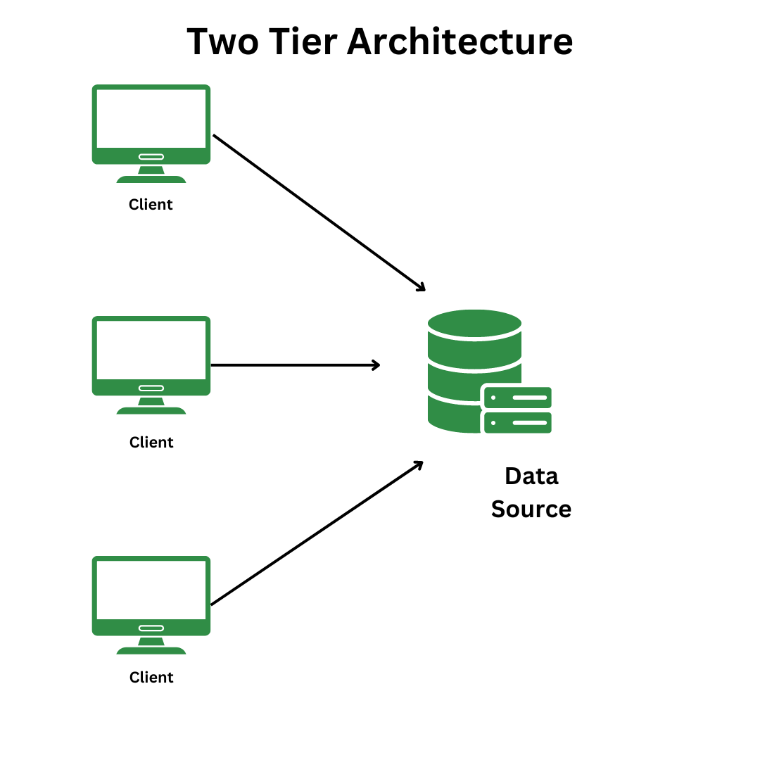
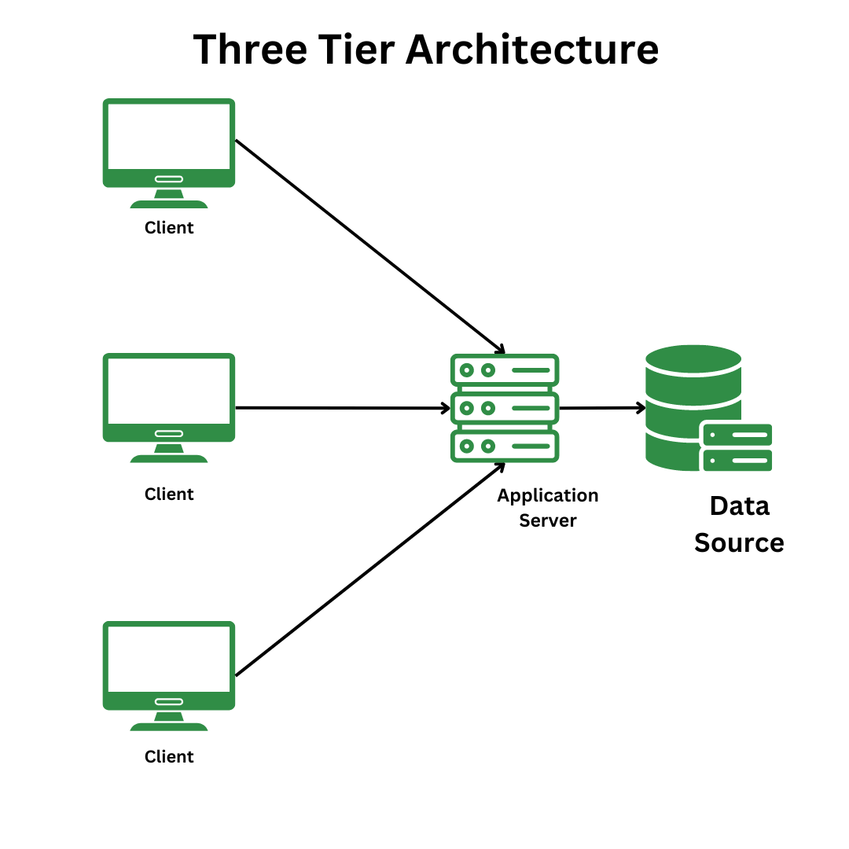

Slide 7
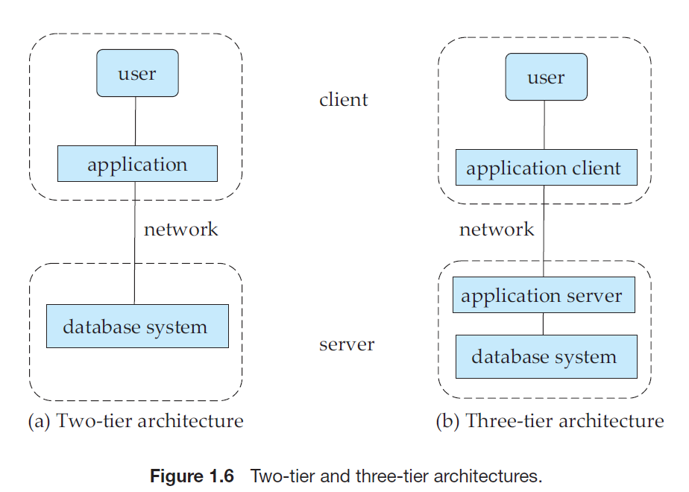

Slide 8
Three-Tier Database Architecture
The three-tier DB architecture is a type of web-based application.
A three-tier DB architecture buries the process or application logic in the middle-tier. Thus, it acts as a separate entity from the Client/ User Interface and the data Interface.
The three-tier DB architecture does not allow its clients and database to communicate directly- thus making it comparatively more secure in the long run.
A few examples of the three-tier database architecture are a website on the Internet, the process of designing registration forms with buttons, labels, text boxes, and many more.

Slide 9
Three-tier architecture is generally divided into three:
Presentation Layer (Client tier): This is the topmost layer of an application whose main function is to communicate with the application layer. This layer passes information which is given by the user in terms of keyboard actions and mouse clicks to the application layer.
Application Layer (Business tier): This layer consists of logic controls and functionality that processes data received from the presentation layer and database layer. It acts as an intermediary between the presentation and database layer.
Database Layer (Data tier): This layer stores data and contains methods that connect to the database and performs the required actions, which include: UPDATE, DELETE or INSERT.

Slide 10
Three schema Architecture
The three schema architecture separates the logical and physical aspects of the DBMS. This allows changing one layer of the database without affecting the other layers. It also helps to maintain data integrity and consistency.
The overall design of the database is called the database schema.
The collectionm of information stored in the database at a particular moment is called an instance of the database.
It divides the database into three different levels:
Internal Schema (Physical Level)
Conceptual Schema (Logical Level)
External Schema (View Level)

Slide 11
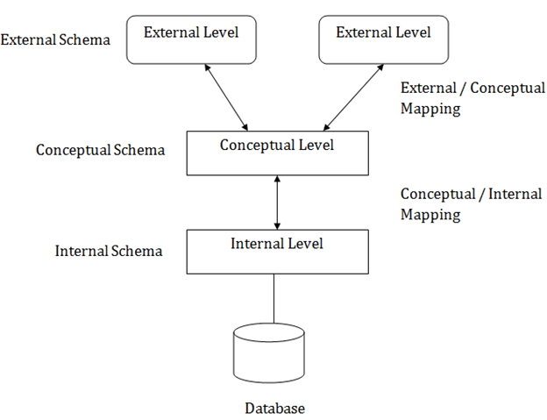

Slide 12
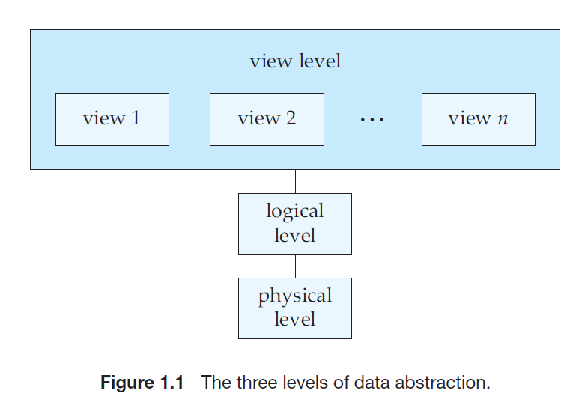

Slide 13
1. Internal Schema (Physical Level)
The Internal Schema is the lowest level in the Three Schema Architecture. It describes how the data is stored in the physical computer the database system. This schema defines the file structures, indexing methods, and the actual storage mechanisms used by the DBMS.
2. Conceptual Schema (Logical Level)
The conceptual schema layer defines how data is structured within a database. It provides the tools for database administrators to create the logical layer of the database.
The Conceptual Schema sits between the Internal Schema and the External Schema and represents the logical view of the entire database while hiding the details of physical storage structures.
It only defines the structure of the data, including relationships, constraints, and entities, And what kind of data is to be stored in the database. Database administrators and programmers often use this schema to define the database's core structure.

Slide 14
3. External Schema (View Level)
The External Schema defines how individual users or user groups view the data.
It represents the user perspective and focuses on the specific requirements of users while hiding the rest of the database from that user group. Depending on their access needs, users may have different views of the same data. The view schema describes the end-user interaction with database systems.

Slide 15
Data Independence
Data independence means a change of data at one level should not affect another level. Two types of data independence are present in this architecture:
Physical Data Independence: Any change in the physical location of tables and indexes should not affect the conceptual level or external view of data.
Conceptual Data Independence: This means a change in conceptual schema should not affect external schema. e.g.; Adding or deleting attributes of a table should not affect the user’s view of the table. But this type of independence is difficult to achieve as compared to physical data independence.

Slide 16
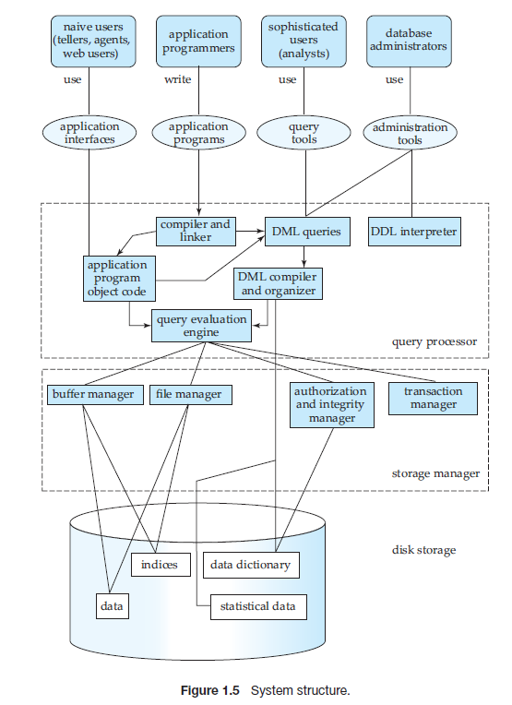

Slide 17
The storage manager is the component of a database system that provides the interface between the low-level data stored in the database and the application programs and queries submitted to the system.
Authorization and integrity manager, which tests for the satisfaction of integrity constraints and checks the authority of users to access data.
Transaction manager, which ensures that the database remains in a consistent (correct) state despite system failures, and that concurrent transaction executions proceed without conflicting.
File manager, which manages the allocation of space on disk storage and the data structures used to represent information stored on disk.
Buffer manager,which is responsible for fetching data from disk storage into main memory, and deciding what data to cache in main memory.

Slide 18
Data files, which store the database itself.
Data dictionary, which stores metadata about the structure of the database, in particular the schema of the database.
Indices, which can provide fast access to data items. Like the index in a textbook.
The query processor components include:
DDL interpreter,which interprets DDL statements and records the definitions in the data dictionary.
DML compiler,which translates DML statements in a query language into an evaluation plan consisting of low-level instructions that the query evaluation engine understands.
Query evaluation engine, which executes low-level instructions generated by the DML compiler.

Slide 19
A transaction is a collection of operations that performs a single logical function in a database application. Each transaction is a unit of both atomicity and consistency.
The transaction manager consists of the concurrency-control manager and the recovery manager.

Slide 20
Different Types of Database Users
Database users are categorized based on their interaction with the database. There are seven types of database users in DBMS. Below mentioned are the types of database users:
Database Administrators (DBA)
Database Designers
System Analysts
Application Programmers
Naive Users / End Users
Sophisticated Users
Casual Users / Temporary Users

Slide 21
Database Administrators (DBA)
Database Administrator is an individual or a team of users who defines the database schema and takes charge of controlling various levels of the database within the organization.
They have full control of the database and they are sometimes known as the super-users of the database. They work alongside developers in order to discuss and design the overall structure of the database including layouts, functionalities, workflow, etc.

Slide 22
Key Responsibilities of DBA:
Schema Definition: DBAs define the structure of the database, including tables, indexes, and relationships.
Storage structure and access-method definition.
Schema and physical-organization modification.
Granting of authorization for data access.
Routine maintenance.
Security Management: They set up user accounts, manage access permissions, and ensure that data is protected from unauthorised access.
Performance Monitoring: DBAs continuously monitor the database’s performance and optimise it for speed and efficiency.
Backup and Recovery
Data Integrity: They make sure that the data remains accurate and consistent over its lifecycle.

Slide 23
Naive / End Users:
Naive or Parametric End Users are those who interact with the database without having any deep knowledge of its inner workings. They rely on pre-developed applications to perform their tasks. These database users in DBMS are typically focused on completing specific, often repetitive tasks.
Characteristics:
No DBMS Knowledge: They do not need to understand how the database works.
Use Pre-Developed Applications: Interaction with the database is through applications with user-friendly interfaces.
Task-Oriented: Their primary focus is on performing specific tasks, like data entry or retrieval.

Slide 24
System Analysts
System Analysts come in the middle of end users and the technical support staff. They understand the requirements of the users and translate them into technical needs for the database designers and programmers.
Key Responsibilities:
Requirements Analysis: Understanding and documenting what the users need from the database.
Feasibility Studies: Assessing whether the requirements can be met within the constraints of time, budget, and technology.
Design Oversight: Ensuring that the database design meets the specified requirements.

Slide 25
Sophisticated Users
Sophisticated Users are those who have a deeper understanding of the DBMS. They can directly interact with the database using complex queries and tools. These database users in DBMS often include data analysts, scientists, and engineers who need detailed and flexible access to the data.
Characteristics:
Advanced Knowledge: They understand SQL and other query languages.
Direct Interaction: They use tools and interfaces to run queries, generate reports, and perform complex data analysis.
Flexible Data Access: They need the ability to manipulate and retrieve data in various ways to suit their needs.

Slide 26
Database Designers
Data Base Designers are the users who design the structure of database which includes tables, indexes, views, triggers, stored procedures and constraints which are usually enforced before the database is created or populated with data.
They are responsible for implementing the overall design of the database. They decide which form of data needs to be stored, what kind of relations exist among different entities of the database, what will be the type of attributes, etc.

Slide 27
Application Programmers
Application programmers are the people who write the actual code that interacts with the database. They develop applications that enable the user to carry out different operations on the data and guarantee that they are intuitive and effective.
Key Responsibilities:
Developing Applications: Writing code to build applications that interact with the database.
Maintaining Code: Regularly updating and debugging applications to ensure they run smoothly.
Optimising Performance: Ensuring that the applications are optimised for speed and efficiency.
User Support: Providing support and updates to ensure that user needs are met effectively.

Slide 28
Casual Users / Temporary Users
Casual Users, also known as Temporary Users, interact with the database occasionally and for specific purposes. They usually require the database for tasks that do not occur on a daily basis but are crucial when needed.
Characteristics:
Occasional Access: They access the database intermittently, often to gather specific information.
User-Friendly Interfaces: They rely on interfaces that are easy to use and understand without needing in-depth knowledge of the DBMS.
Specific Tasks: Their interaction is task-oriented, such as generating reports or retrieving specific data.

Slide 29
Database Languages
Database languages are specialized languages used to interact with a database. They allow users to perform different tasks such as defining, controlling and manipulating the data.
DDL (Data Definition Language)
DML (Data Manipulation Language)
TCL (Transaction Control Language)

Slide 30
1. DDL (Data Definition Language)
The DDL stands for Data Definition Language, Which is used to define the database's internal structure and Pattern of the Database.
It is used to define and modify the structure of the database itself, including the tables, views, indexes and other schema-related objects.
It deals with the creation and modification of database schema, but it doesn't deal with the data itself. Following are the five DDL commands in SQL:
CREATE: Used to create database objects like tables, indexes or views.
ALTER: Used to modify the structure of an existing database object, such as adding a new column to a table.
DROP: Used to delete database objects.
TRUNCATE: Used to remove all rows from a table, without affecting the structure.
RENAME: Used to change the name of a database object.

Slide 31
The output of the DDL is placed in the data dictionary,which contains metadata—that is, data about data.
The data dictionary is considered to be a special type of table that can only be accessed and updated by the database system itself (not a regular user).
The database system consults the data dictionary before reading or modifying actual data.
The data values stored in the database must satisfy certain consistency constraints.
The DDL provides facilities to specify such constraints. The database system checks these constraints every time the database is updated.

Slide 32
2. DML (Data Manipulation Language)
The DML (Data Manipulation Language) is used to manage and manipulate data within a database.
With DML, you can perform various operations such as inserting, updating, selecting and deleting data.
There are basically two types:
Procedural DMLs require a user to specify what data are needed and how to get those data.
Declarative DMLs (also referred to as nonprocedural DMLs) require a user to specify what data are needed without specifying how to get those data. Declarative DMLs are usually easier to learn and use than are procedural DMLs.
A query is a statement requesting the retrieval of information.
The portion of a DML that involves information retrieval is called a query language.

Slide 33
These operations allow you to work with the actual content in your database tables.
SELECT: Retrieves data from the table based on specific criteria.
INSERT: Adds new rows of data into an existing table.
UPDATE: Modifies existing data in a table.
DELETE: Removes data from a table.
MERGE: Performs an "upsert" operation, which means updating existing records or inserting new ones if they don’t exist.

Slide 34
3. TCL ( Transaction Control Language )
The TCL full form is Transaction Control Language commands are used to manage and control transactions in a database, grouping them into logical units.
TCL commands ensure that database transactions are processed reliably. They help us commit changes or roll them back, maintaining data integrity.
These commands help ensure the integrity of data and consistency during complex operations.
Here are the two main commands in this category:
Commit: Saves all the changes made during the current transaction to the database. These are very useful in the banking sector.
Rollback: used to restore the database to its original state from the last commit. This command also plays an important role in Banking Sectors.

Slide 35
Data Models in DBMS

Slide 36
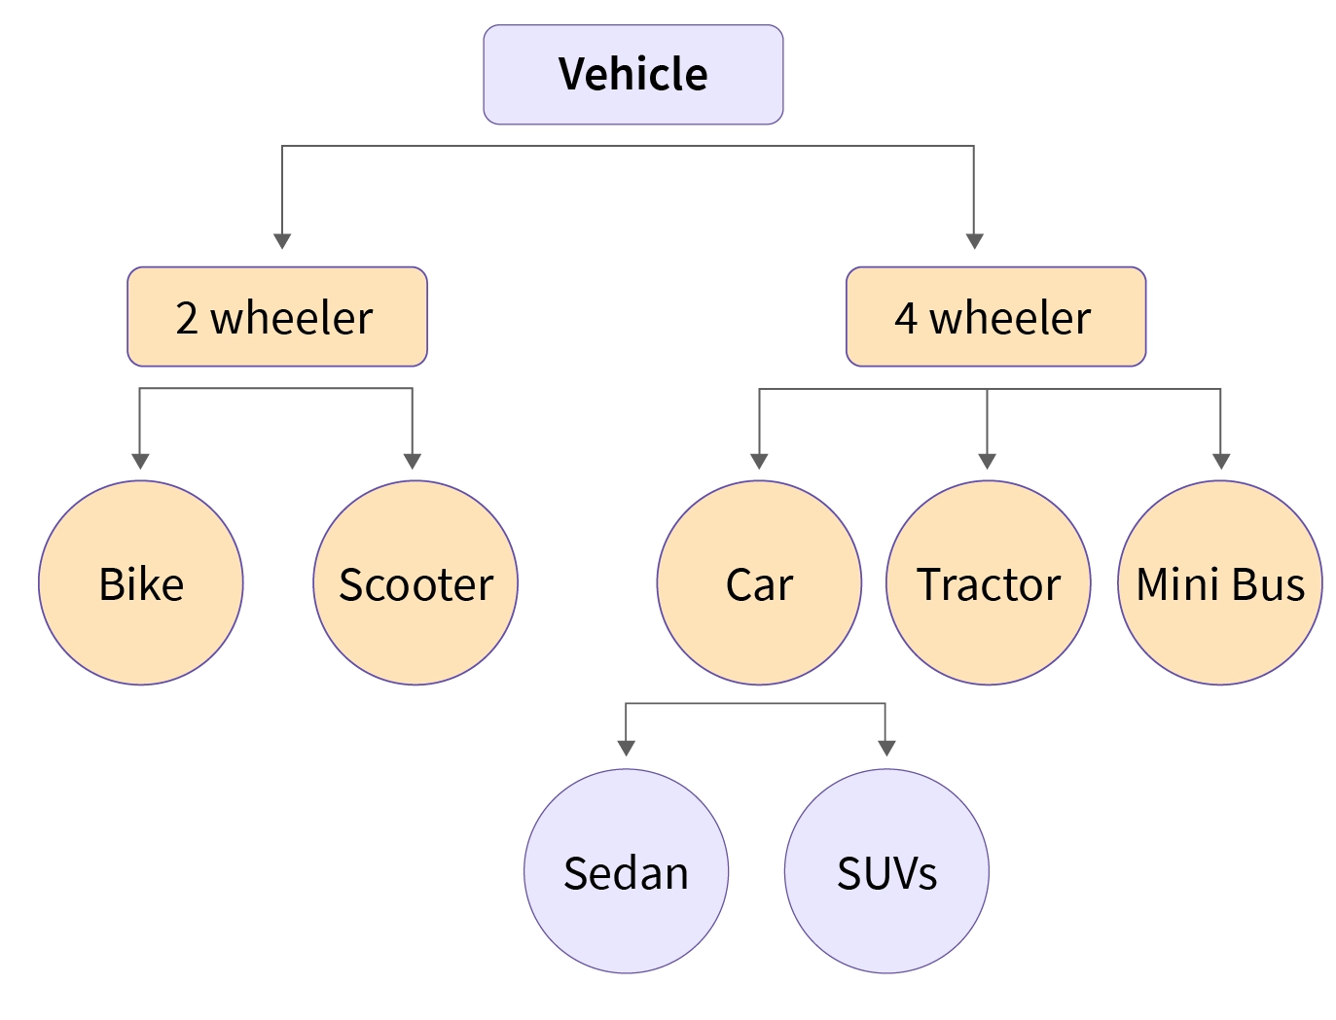
Hierarchical Model
The hierarchical data model is one of the oldest data models, developed in the 1950s by IBM. In this data model, the data is organized in a hierarchical tree-like structure.
Data is organized into a tree-like structure with a one-to-many relationship between two different types of data,
This data model can be easily visualized because each record in DBMS has one parent and many children as shown in the image given.
The main drawback we can see here is we can only have one too many relationships under this model, hence the hierarchical data model is very rarely used nowadays.
Because it has one-to-many relationships between different types of data so it is easier and fast to fetch the data. But the Hierarchical model is less flexible. Doesn't support many-to-many relationships.

Slide 37
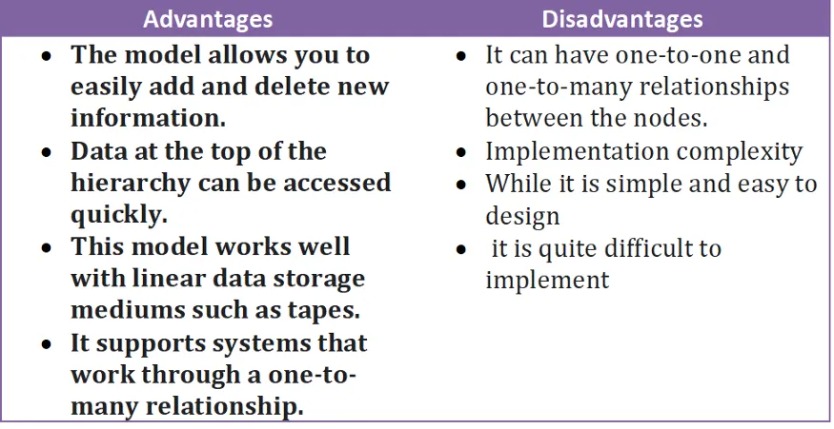

Slide 38
Network Model
The Network Model is an extension of the Hierarchical model.
In this model, data is organized more like a graph, and allowed to have more than one parent node.
In the network database model, data is more related as more relationships are established in this database model.
Also, as the data is more related, hence accessing the data is also easier and fast.
This database model uses many-to-many data relationships.
The network model in DBMS can be represented as a graph and hence it replaces the hierarchical tree with a graph in which object types are the nodes and relationships are the edges.

Slide 39
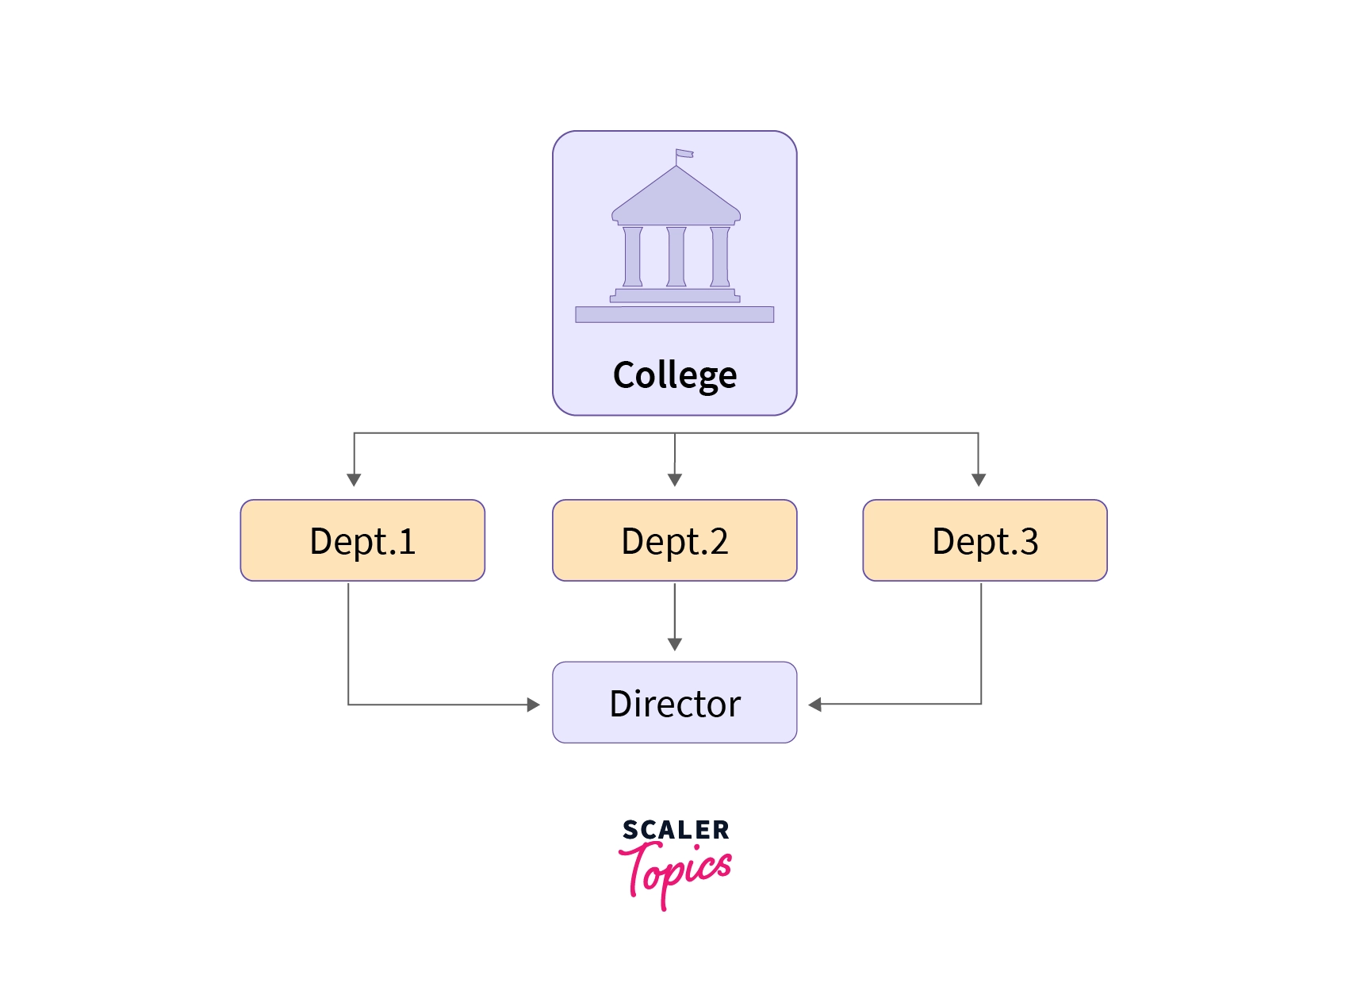
Here you can see all three departments are linked with the director which was not possible in the hierarchical data model.
In the network model, there can be many possible paths to reach a node from the root node (College is the root node in the above case), therefore the data can be accessed efficiently when compared to the hierarchical data model.
But, on the other hand, the process of insertion and deletion of data is quite complex.

Slide 40
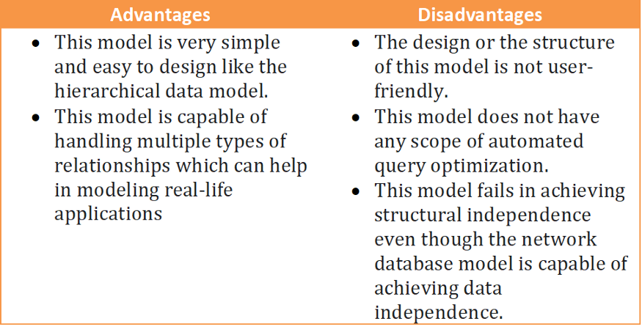

Slide 41
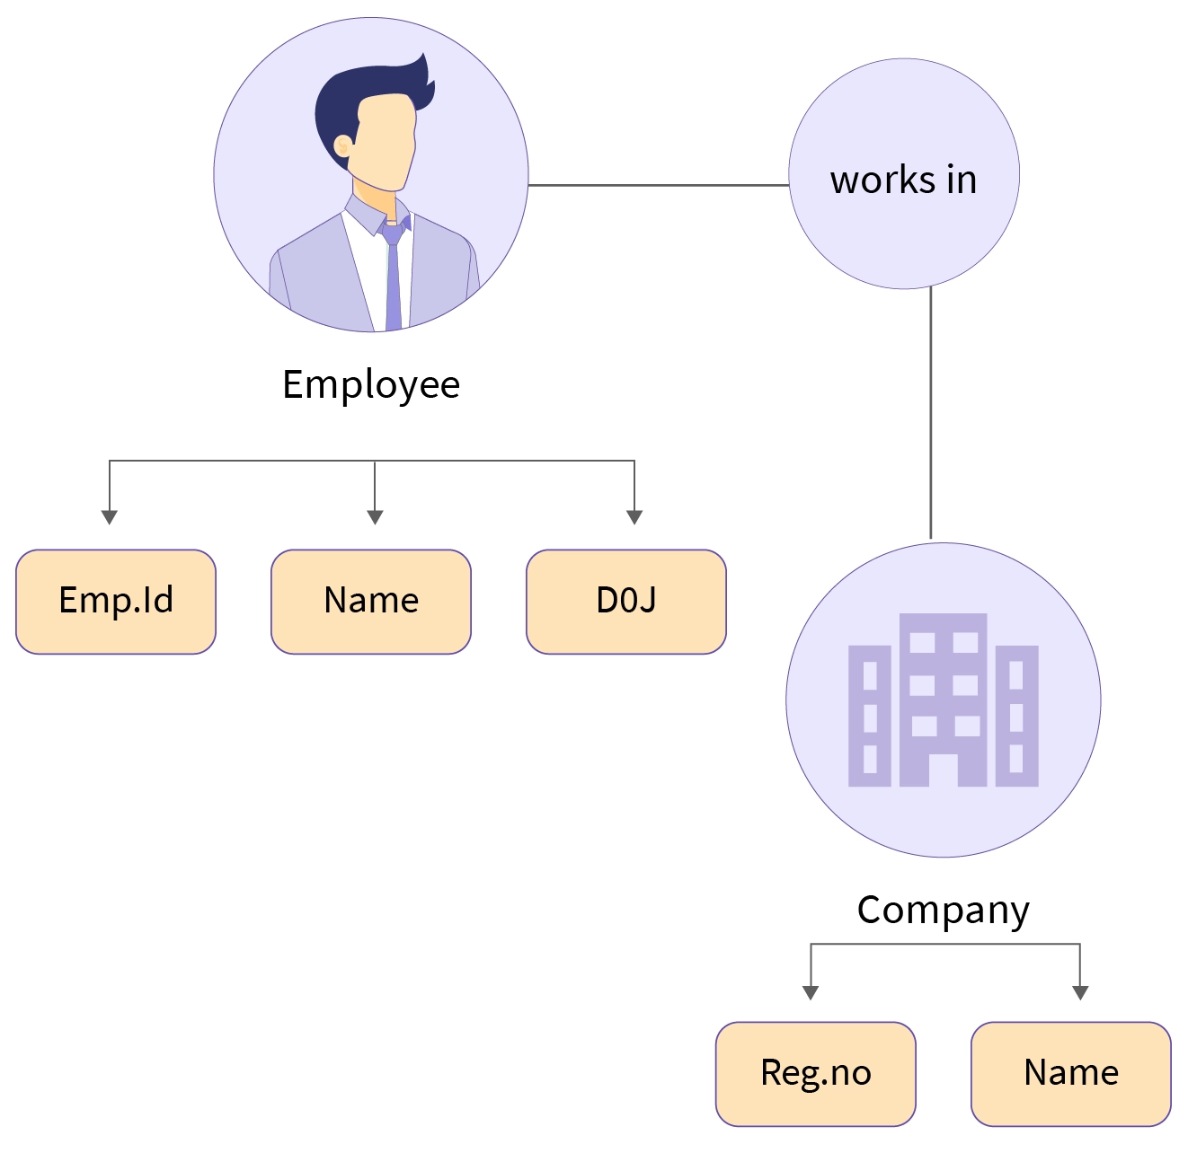
Entity-Relationship Model (ER Model)
An ER model is a high-level data model that describes the structure of the database in a pictorial form which is known as ER-diagram.
In simple words, an ER diagram is used to represent logical structure of the database easily.
ER model develops a conceptual view of the data hence it can be used as a blueprint to implement the database in the future.

Slide 42
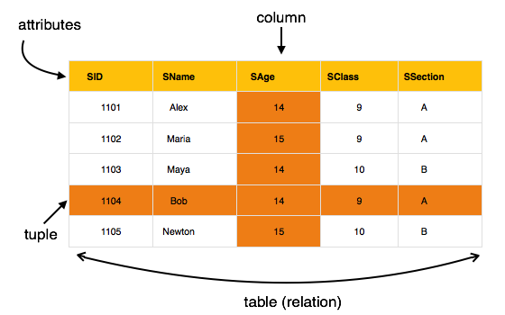
Relational Model
This is the most widely accepted data model. In this model, the database is represented as a collection of relations in the form of rows and columns of a two-dimensional table. Each row is known as a tuple (a tuple contains all the data for an individual record) while each column represents an attribute.

Slide 43
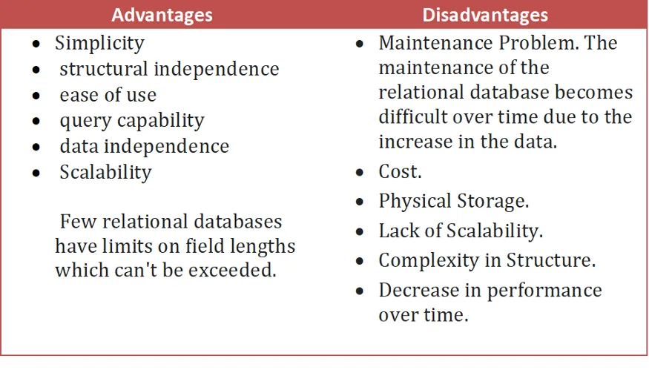

Slide 44
Object-Oriented Data model
As suggested by its name, the object-oriented data model is a combination of object-oriented programming and relational data model.
In this data model, the data and their relationship are represented in a single structure which is known as an object.
Since data is stored as objects we can easily store audio, video, images, etc in the database which was very difficult and inconvenient to do in the relational model.
A very popular example of an Object Database management system or ODBMS is MongoDB

Slide 45
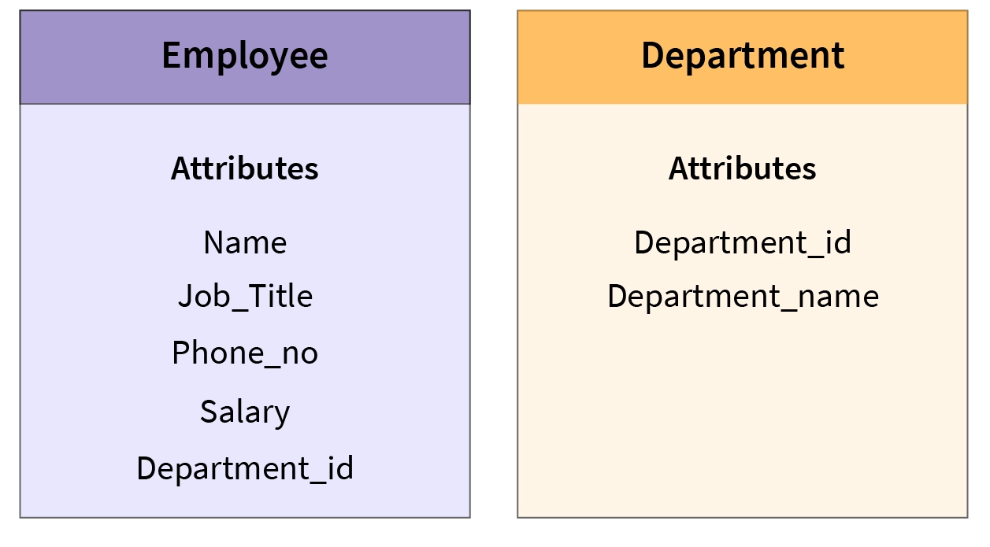
As shown in the image below two objects are connected with each other through links.
In the above image, we have two objects that are Employee and Department in which all the data is contained in a single unit (object).
They are linked with each other as they share a common attribute i.e. Department_Id.

Slide 46
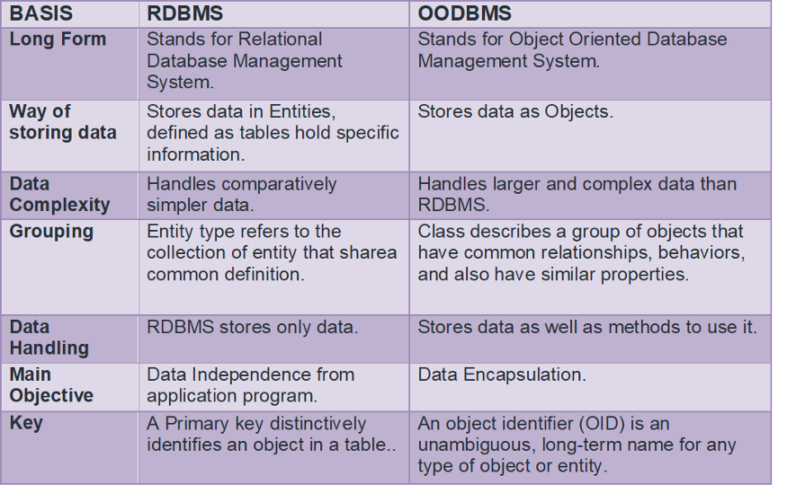

Slide 47
Semi-Structured Data Model
A semi-structured data model is a generalized form of the relational model, which allows representing data in a flexible way, hence we can not differentiate between data and schema in this model because, in this model, some entities have a missing attribute(s) and on the other hand, some entities might have some extra attribute(s) which in turn makes it easy to update the schema of the database.
Semi-structured data refers to the structured data that doesn’t adhere to the tabular structure of the data models that are associated with relational DBs or any other types of data tables.
It includes tags or any other markers in order to segregate semantic pieces and enforce hierarchies of fields and records within the data. As a result, it’s known as a self-descriptive structure.
A common example of this type of data model is web-based data sources

Slide 48
Advantages of Data Models in DBMS
Data models ensure that the data is represented accurately.
The relationship between the data is well-defined.
Data Redundancy in DBMS can be minimized and missing data can be identified easily.
Last but not least, the security of the data is not compromised.

